Slide 1
Unit of work pattern
Creating a transactional system with the repository and Unit of work design patterns
Notes:
Please utilize the “AzureStorageTest_Example” solution in the class repository for an example project that is completed.
This solution also contains many notes about the different aspects of the code that is written for this chapter.

Slide 2
Why use the unit of work design pattern
Azure Cloud Storage has no support for transactions across multiple tables.
This means that if a process updates many tables, we have to create a way to synchronize these transactions.
If one transaction fails, it is important to ensure that all transactions that have been completed get reversed. This ensures that the data in the database tables is consistent and accurate.
Keeps track of manipulated objects in order to synchronize in-memory data with the data store.
Provides a single transaction for multiple queries.
The Unit of Work commits the transaction.
If the commit fails, rollback.
Single commit call on the database.
All object tracking information is centralized.
Provides a firm means for complex scenarios like handling business transactions that span several system transactions using Optimistic Offline Lock and Pessimistic Offline Lock.

Slide 3
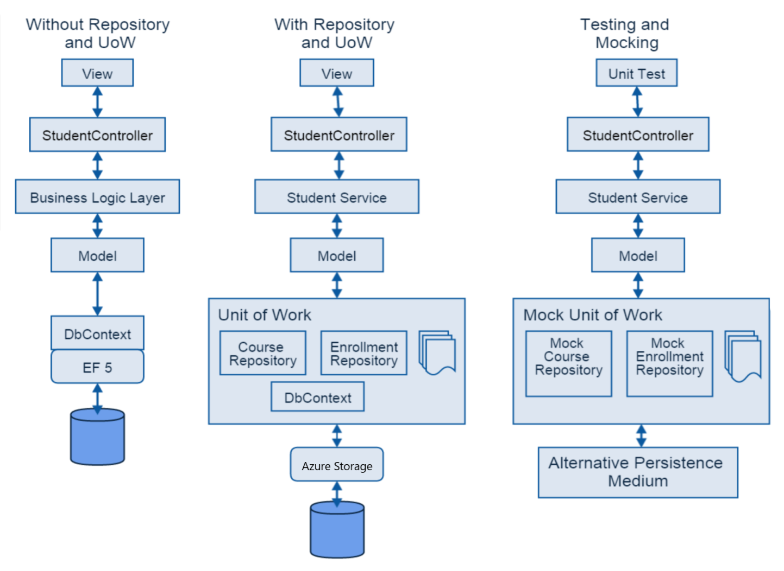
Why use the unit of work design pattern
Without Repositories and the Unit of Work Pattern we are limited to single table transactions that does not allow for flexibility and consistency when performing complex actions.
With the Unit of Work Pattern, we can create a “system” that will manage multiple table transactions and perform them all at the same time.
Testing becomes easy with the Unit of Work Pattern because we can create “Mock” Unit of Works and submit them through our testing system. We will be doing this in later chapters.

Slide 4
Asynchronous Methods
Asynchronous Methods are used to perform multi-threaded operations in C# and .NET. They will always return a “Task” which is associated with the current system thread for the operation that is being performed. Asynchronous methods usually end with “async”.
The main benefits of asynchronous programming using async / await include the following:
Increase the performance and responsiveness of your application, particularly when you have long-running operations that do not require to block the execution. In this case, you can perform other work while waiting for the result from the long running task.
Organize your code in a neat and readable way significantly better than boilerplate code of the traditional thread creation and handling. with async / await , you write less code and your code will be more maintainable than using the previous asynchronous programming methods such as using plain tasks.
async / await is the newer replacement to BackgroundWorker, which has been used on windows forms desktop applications.
You make use of the latest upgrades of the language features, as async / await was introduced in C# 5, and there have been some improvements added to the feature like foreach async and generalized async type like ValueTask.

Slide 5
Why use Asynchronous Methods
I/O bound code
This is when you want to do an input/output operation, particularly, downloading big resource from network, reading a huge file or accessing a database resource. In this case, you use the await keyword on an async method that returns a Task or Task<T>.
CPU bound code
This is when you want to do a heavy in-app calculation, such as calculating and displaying the remaining distance to reach the finish line of a car racing game. Image what will happen if the was done synchronously and the UI was blocked while calculating the remaining distance when the car is moving?! Therefore, In the CPU bound case, you use the await keyword on an async method that will be running on a background thread using the method Task.Run()
In both scenarios, your application's UI or service's responsiveness or running state should not be blocked or affected.
For every async method, the .NET framework will create a state machine to keep track of the calls and what should be done after the awaitable task has complete. Check this comprehensive in-depth article about async / await compilation and state machines, Also if you want to learn more about Async and what happens behind the scenes of Task and Task<T>, read Async in Depth.

Slide 6
SQL Operations - CRUD
C – Create
Operations that create new data into a database. This is generally associated with the “Insert” SQL command.
R – Retrieve(Read)
Operations that retrieve information from a database. This is generally associated with the “Select” SQL command.
U – Update
Operations that alter current data in a database. This is generally associated with the “Update” SQL command.
D – Delete
Operations that remove data from a database. This is generally associated with the “Delete” SQL command.

Slide 7
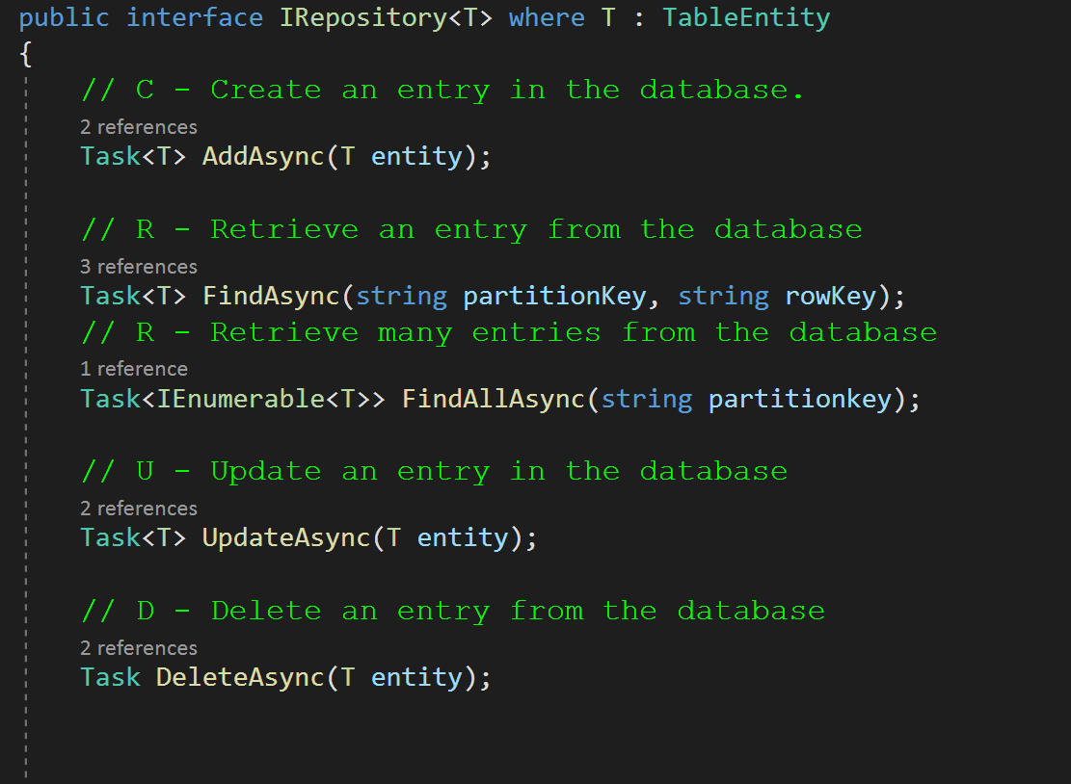
CRUD and IRepository Pattern
Our IRepository handles all aspects of CRUD operations.
C – AddAsync(T entity);
R – FindAsync(string partitionKey, string rowKey);
R – FindAllAsync(string partitionKey);
U – UpdateAsync(T entity);
D – DeleteAsync(T entity);
Using our IRepository we can create concrete repositories that manage all of our CRUD operations that we will use with the database.
NOTE: The IRepository interface can have as many CRUD operations as we want and is not limited to what we will have for this class. This class is designed to introduce the basic concepts only.

Slide 8
Create the IRepository Interface
In the project that was created in the previous class (AzureStorageTest.sln), create a new interface named IRepository. This will be the interface that we will implement on our repositories to ensure that each of our repositories will manage their own CRUD operations on the database.
Once created, code the methods that this interface will have based on the book.

Slide 9
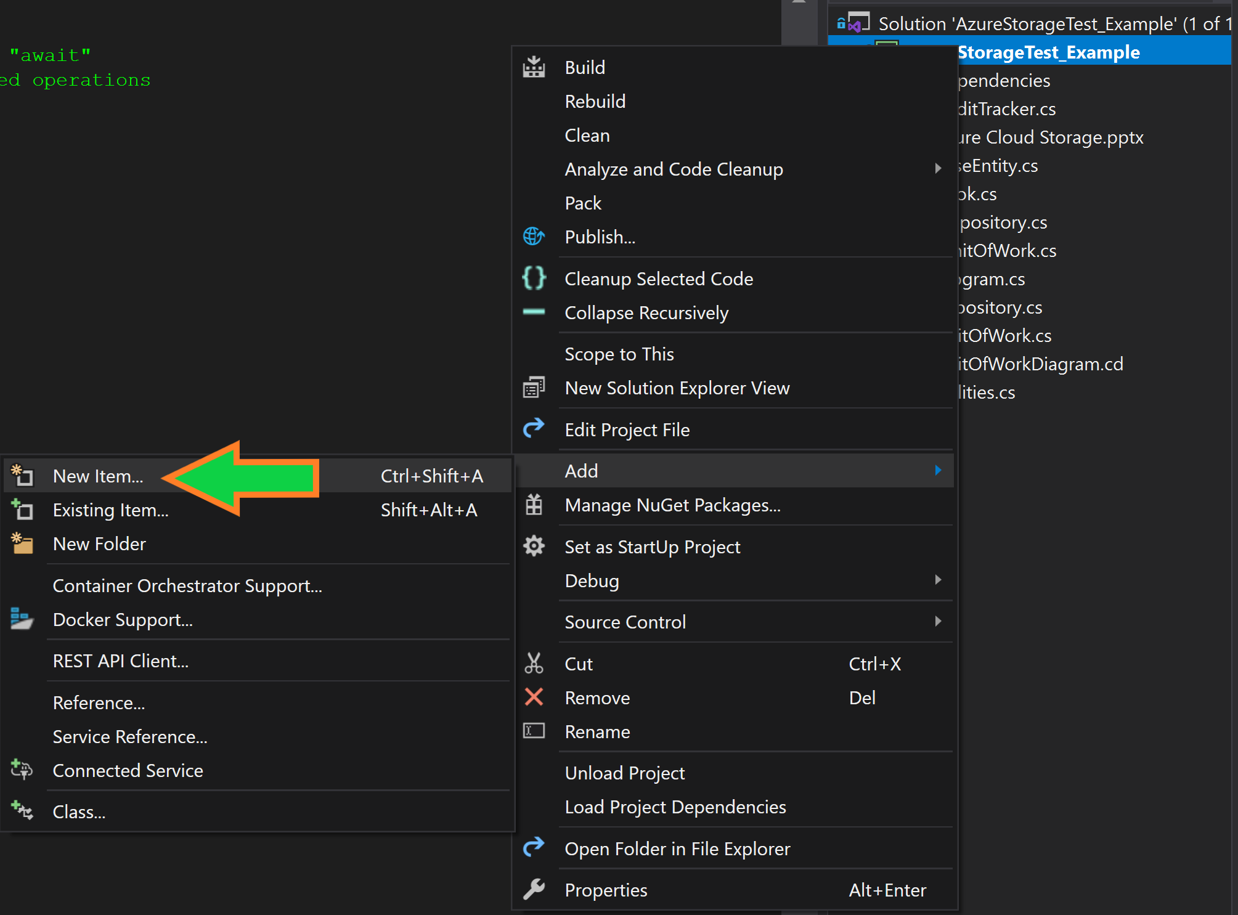
Create the IRepository Interface

Slide 10
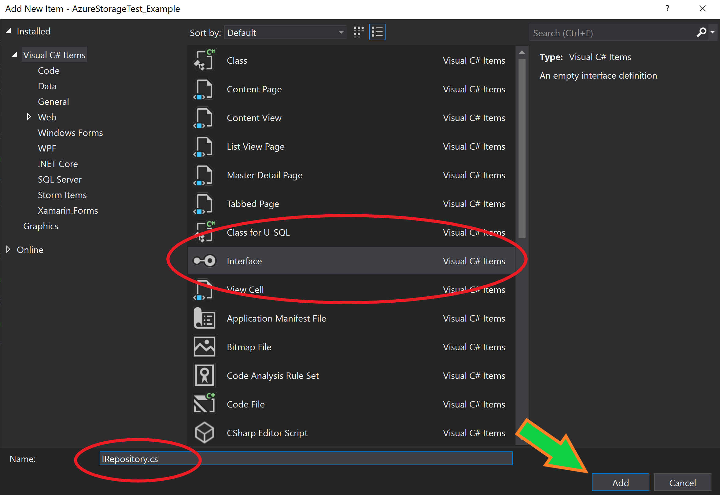
Create the IRepository Interface
Notes:
Task<T> AddAsync(T entity);
Task<T> UpdateAsync(T entity);
Task DeleteAsync(T entity);
Task<T> FindAsync(string partitionKey, string rowKey);
Task<IEnumerable<T>> FindAllByPartitionKeyAsync(string partitionkey);
Task<IEnumerable<T>> FindAllAsync();
Task CreateTableAsync();

Slide 11
Create the Repository Base Class
We will create a “base” class called Repository.
This class will be inherited by all classes that we want to have associated with database tables.
This class will implement the CRUD operations, we do not want to code these operations for each of the sub-classes(children) since all of the operations will be the same regardless of what “repository type” we will be using. The communication with the database and CRUD operations will be the same for all of them.

Slide 12
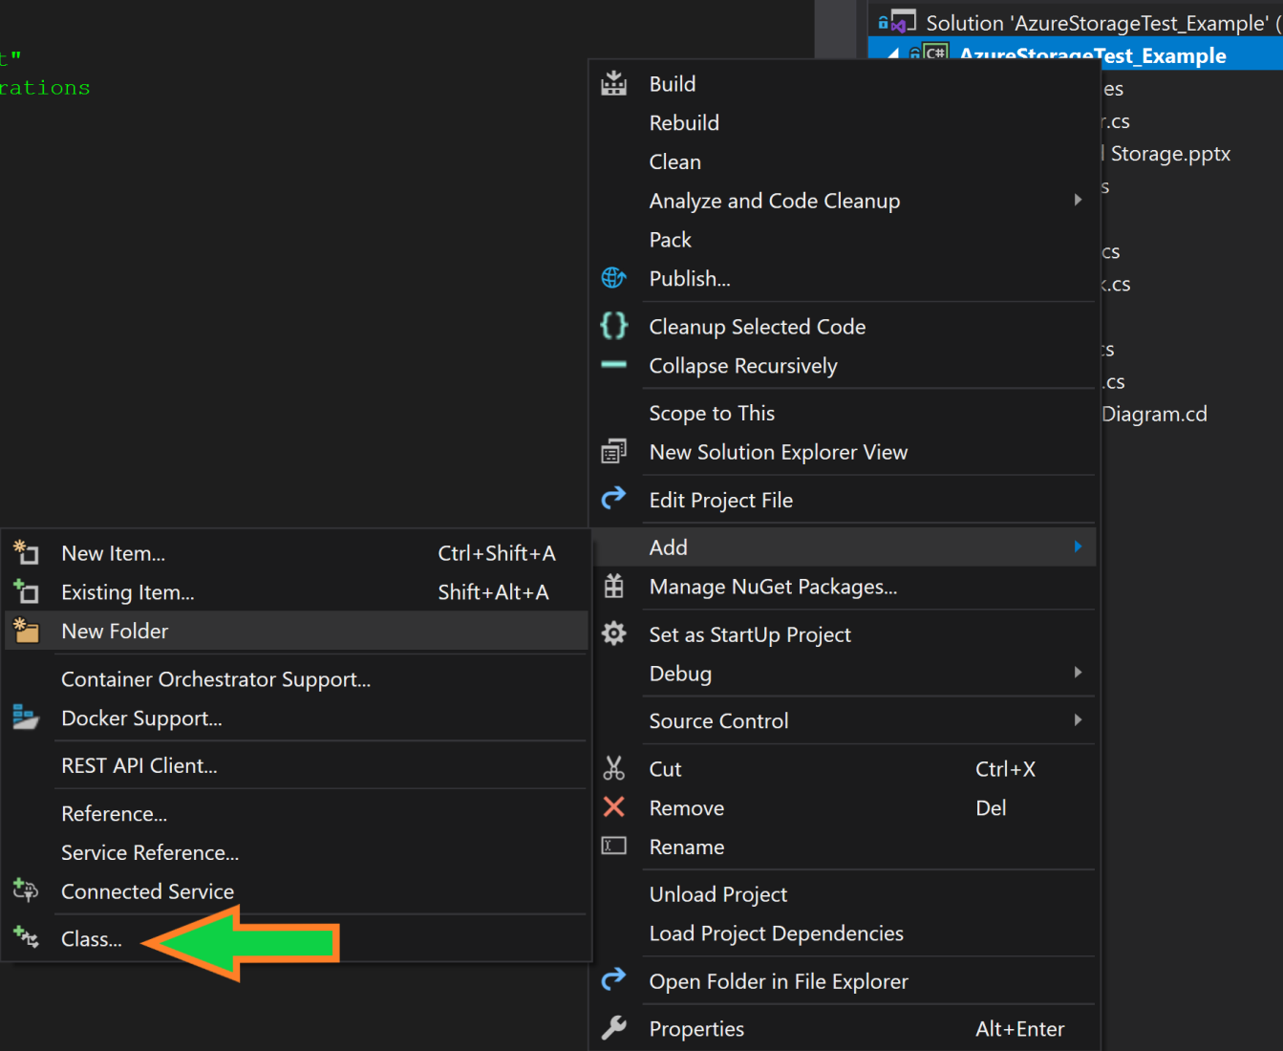
Create the Repository Class

Slide 13
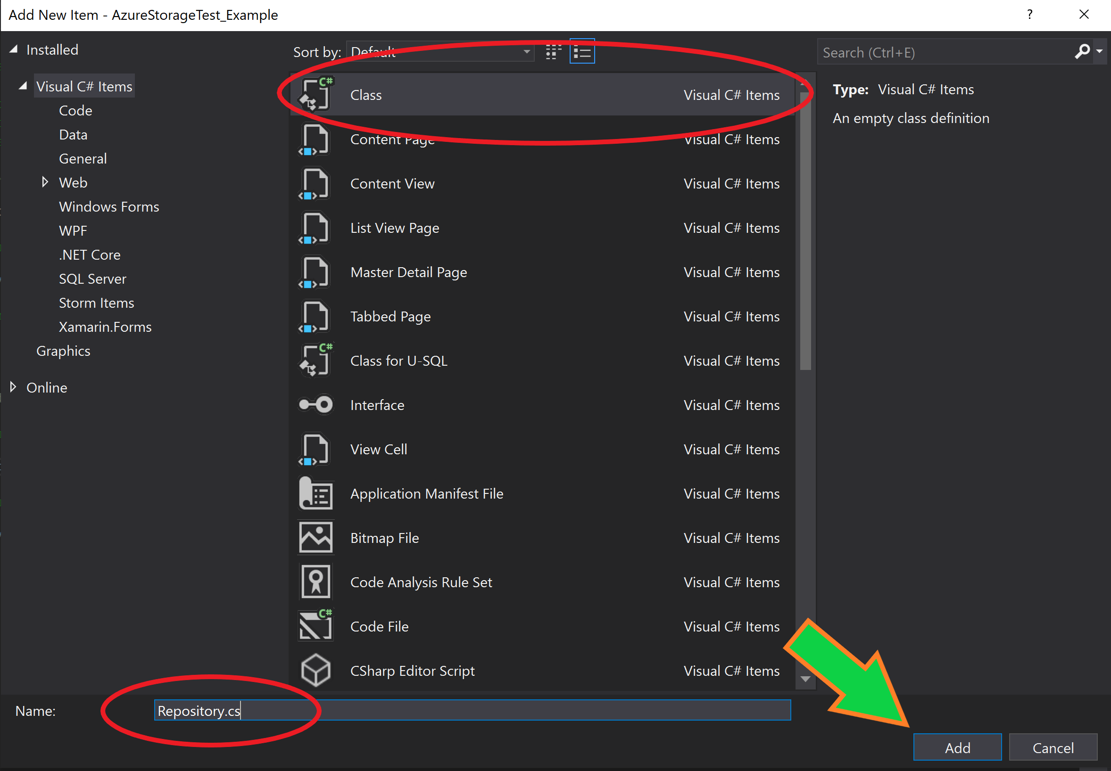
Create the Repository Class
Notes:
using ASC.DataAccess.Interfaces;
using ASC.Models.BaseTypes;
using ASC.Utilities;
using Microsoft.WindowsAzure.Storage;
using Microsoft.WindowsAzure.Storage.Table;
using System;
using System.Collections.Generic;
using System.Threading.Tasks;
using System.Reflection;
namespace ASC.DataAccess {
public class Repository < T >: IRepository < T > where T: TableEntity, new() {
private readonly CloudStorageAccount storageAccount;
private readonly CloudTableClient tableClient;
private readonly CloudTable storageTable;
public IUnitOfWork Scope {
get;
set;
}
public Repository(IUnitOfWork scope) {
storageAccount = CloudStorageAccount.Parse(scope.ConnectionString);
tableClient = storageAccount.CreateCloudTableClient();
CloudTable table = tableClient.GetTableReference(typeof(T).Name);
this.storageTable = table;
this.Scope = scope;
}
}
}

Slide 14
The “CreateRollbackAction” Method
When implementing the Unit of Work pattern, we need to ensure that for each “CRUD action” we perform, we create an action that will “reverse” this action on the database.
For Example:
If we have 5 tables that we are updating, but the 3rd table update fails, we want to “rollback” the previous actions on the database so we can keep the database data “clean” and accurate.
Use the book at add this method to the Respository class. The next slide gives an example with notes.

Slide 15
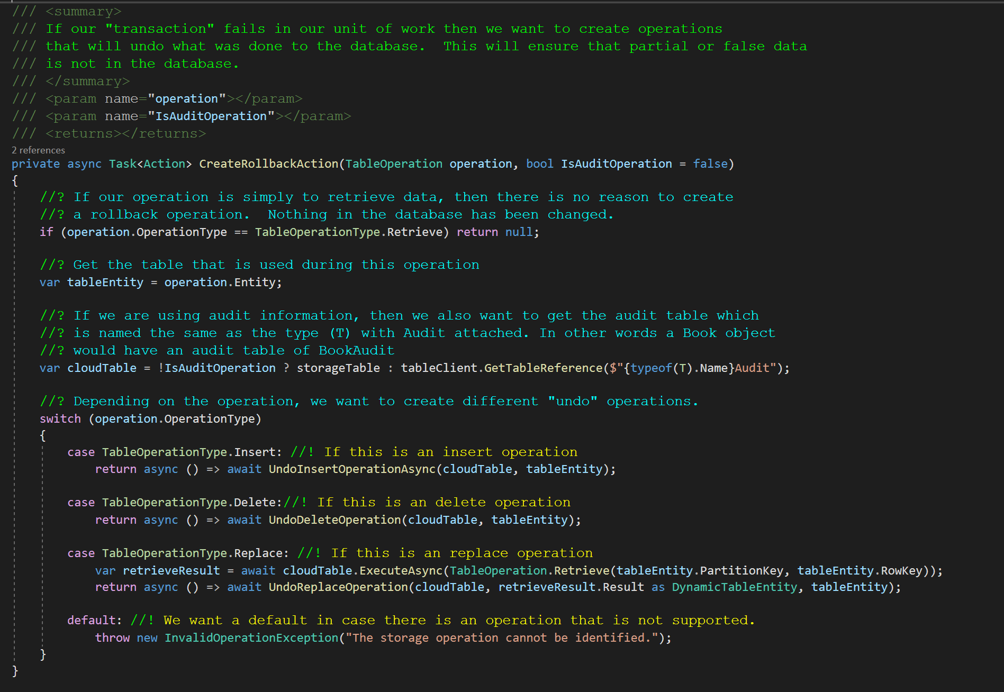
The “CreateRollbackAction” Method
Notes:
private async Task<Action> CreateRollbackAction(TableOperation operation)
{
if (operation.OperationType == TableOperationType.Retrieve) return null;
var tableEntity = operation.Entity;
var cloudTable = storageTable;
switch (operation.OperationType)
{
case TableOperationType.Insert:
return async() = > await UndoInsertOperationAsync(cloudTable, tableEntity);
case TableOperationType.Delete:
return async() = > await UndoDeleteOperation(cloudTable, tableEntity);
case TableOperationType.Replace:
var retrieveResult = await cloudTable.ExecuteAsync(TableOperation.Retrieve(tableEntity.PartitionKey, tableEntity.RowKey));
return async() = > await UndoReplaceOperation(cloudTable, retrieveResult.Result as DynamicTableEntity, tableEntity);
default:
throw new InvalidOperationException("The storage operation cannot be identified.");
}
}

Slide 16
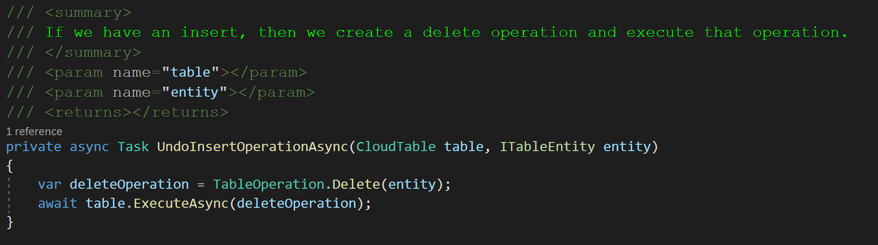
The “UndoInsertOperationAsync” Method
Our insert operation will create a delete operation for the “undo” or “rollback” action. We want to use the same entity that we used for the insert, to ensure that the correct entity that was added to the database is removed from the database when we “rollback” the transaction.
Notes:
private async Task UndoInsertOperationAsync(CloudTable table, ITableEntity entity)
{
var deleteOperation = TableOperation.Delete(entity);
await table.ExecuteAsync(deleteOperation);
}

Slide 17
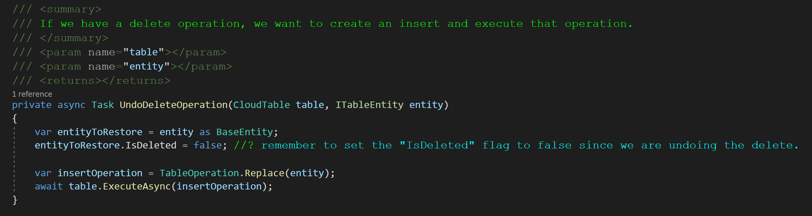
The “UndoDeleteOperationAsync” Method
Our delete operation will create an insert operation for the “undo” or “rollback” action. We want to use the same entity that we used for the delete, to ensure that the correct entity that was removed from the database is added back into the database when we “rollback” the transaction.
Notes:
private async Task UndoDeleteOperation(CloudTable table, ITableEntity entity)
{
var entityToRestore = entity as BaseEntity;
entityToRestore.IsDeleted = false;
var insertOperation = TableOperation.Replace(entity);
await table.ExecuteAsync(insertOperation);
}

Slide 18
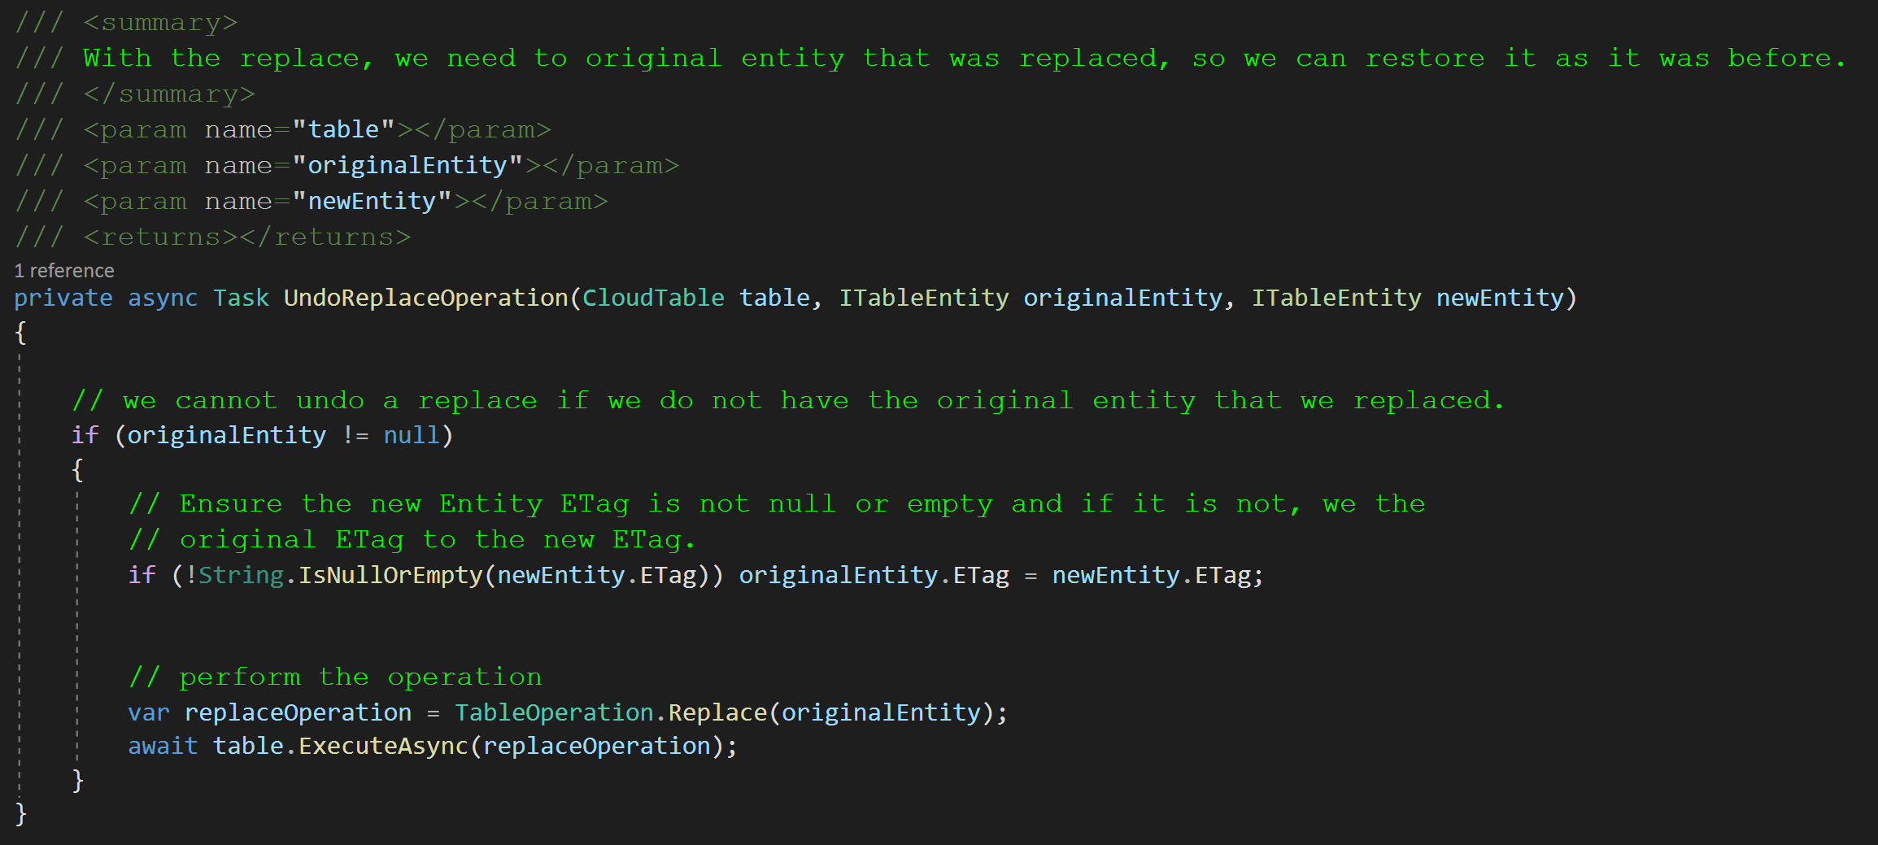
The “UndoReplaceOperationAsync” Method
Our update operation will create an update operation for the “undo” or “rollback” action. We want to use the original entity that was replaced during the operation to ensure that we are putting the same information back into the database as it was before we updated the information.
Notes:
private async Task UndoReplaceOperation(CloudTable table, ITableEntity originalEntity, ITableEntity newEntity)
{
if (originalEntity != null)
{
if (!String.IsNullOrEmpty(newEntity.ETag)) originalEntity.ETag = newEntity.ETag;
var replaceOperation = TableOperation.Replace(originalEntity);
await table.ExecuteAsync(replaceOperation);
}
}

Slide 19
Implement the CRUD Operations
After creating our CreateRollbackActions method, we need to create the CRUD actions that our repository will be using. These include:
AddAsync
FindAsync and FindAllAsync
UpdateAsync
DeleteAsync
These will all use a common “ExecuteAsync” method since the execution of each of these CRUD actions are the same when sending them to the database. Remember, we want to write code as little as possible and reuse as much as we can if many methods do the same thing.

Slide 20
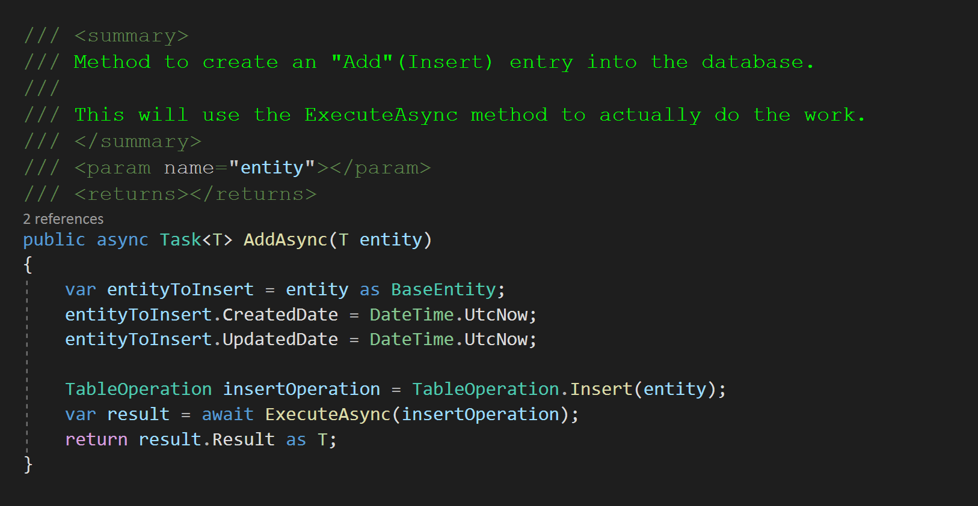
The “AddAsync” Method
This will set the “CreateDate” and “UpdateDate” to the current UTC time. It will then create an “Insert” operation and send it to the ExecuteAsync method. It will return the results of the operation.
Notes:
public async Task<T> AddAsync(T entity)
{
var entityToInsert = entity as BaseEntity;
entityToInsert.CreatedDate = DateTime.UtcNow;
entityToInsert.UpdatedDate = DateTime.UtcNow;
TableOperation insertOperation = TableOperation.Insert(entity);
var result = await ExecuteAsync(insertOperation);
return result.Result as T;
}

Slide 21
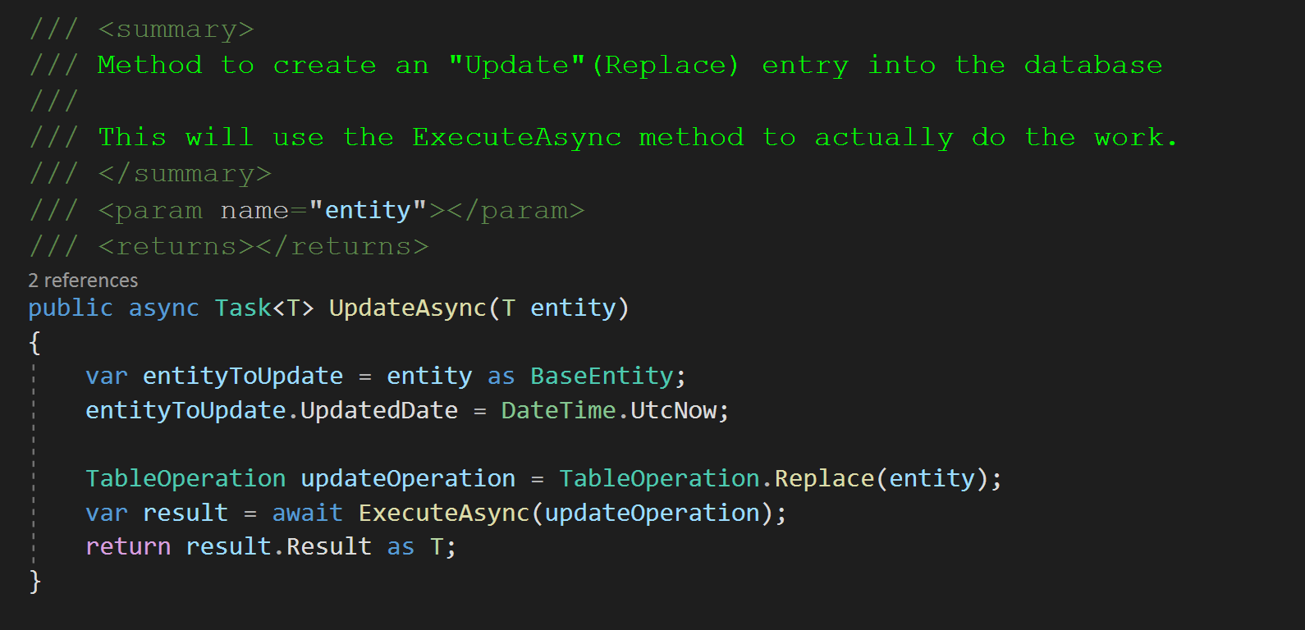
The “UpdateAsync” Method
This will set the “UpdateDate” to the current UTC time. It will then create an “Replace” operation and send it to the ExecuteAsync method. It will return the results of the operation.
Notes:
public async Task<T> UpdateAsync(T entity)
{
var entityToUpdate = entity as BaseEntity;
entityToUpdate.UpdatedDate = DateTime.UtcNow;
TableOperation updateOperation = TableOperation.Replace(entity);
var result = await ExecuteAsync(updateOperation);
return result.Result as T;
}

Slide 22
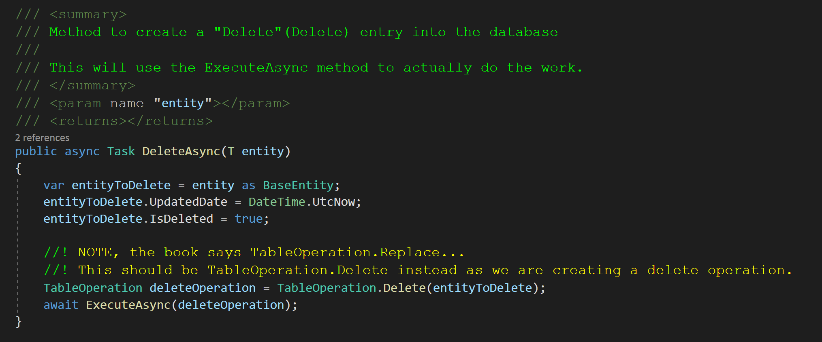
The “DeleteAsync” Method
This will set the “UpdateDate” to the current UTC time. It will also set the IsDeleted flag to true. It will then create an “Delete” operation and send it to the ExecuteAsync method. It will return the results of the operation.
Notes:
public async Task DeleteAsync(T entity)
{
var entityToDelete = entity as BaseEntity;
entityToDelete.UpdatedDate = DateTime.UtcNow;
entityToDelete.IsDeleted = true;
TableOperation deleteOperation = TableOperation.Replace(entityToDelete);
await ExecuteAsync(deleteOperation);
}

Slide 23
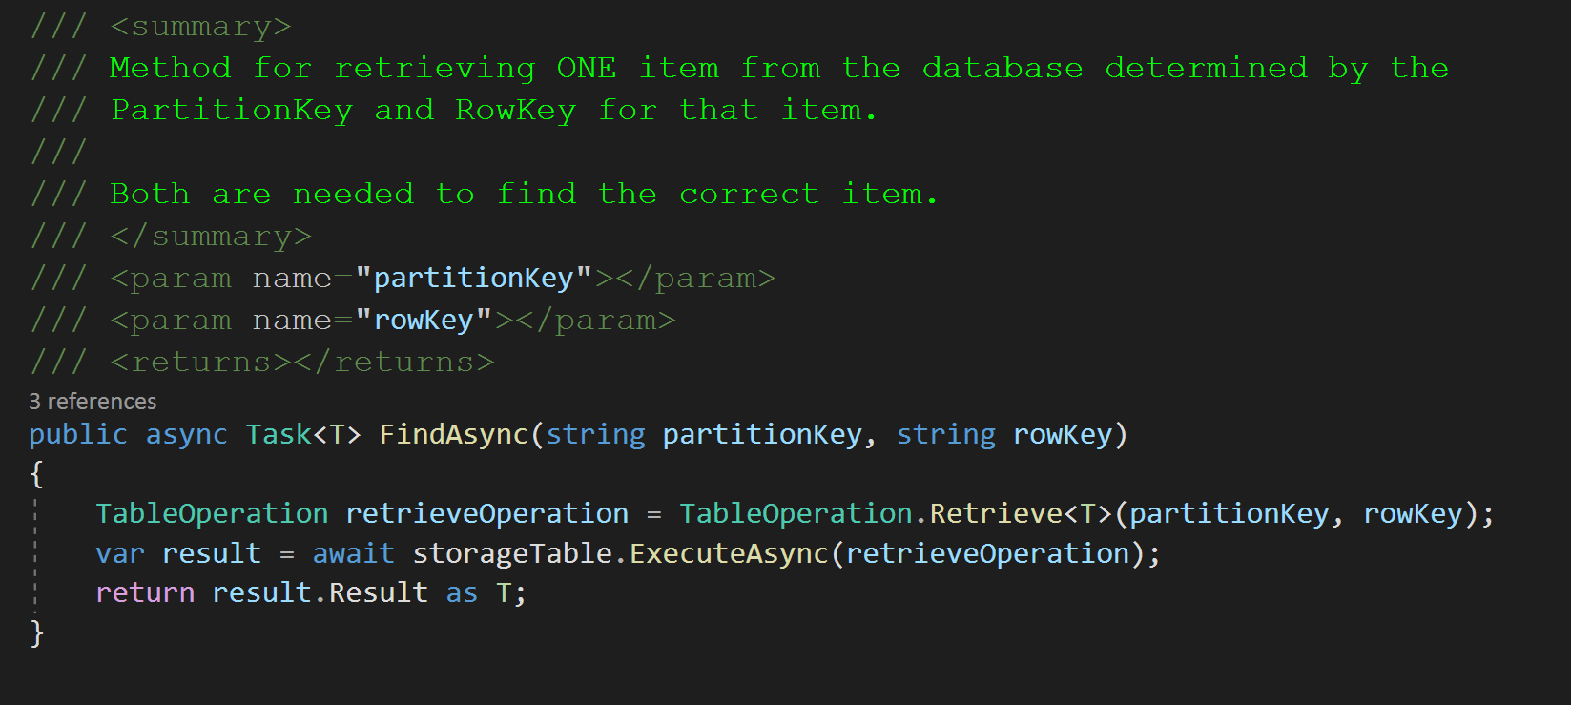
The “FindAsync” Method
This will create a “Retrieve” operation of type T and then send the operation to the ExecuteAsync method.
It will then return the results of the Retrieve operation.
Notes:
public async Task<T> FindAsync(string partitionKey, string rowKey)
{
TableOperation retrieveOperation = TableOperation.Retrieve<T>(partitionKey, rowKey);
var result = await storageTable.ExecuteAsync(retrieveOperation);
return result.Result as T;
}

Slide 24
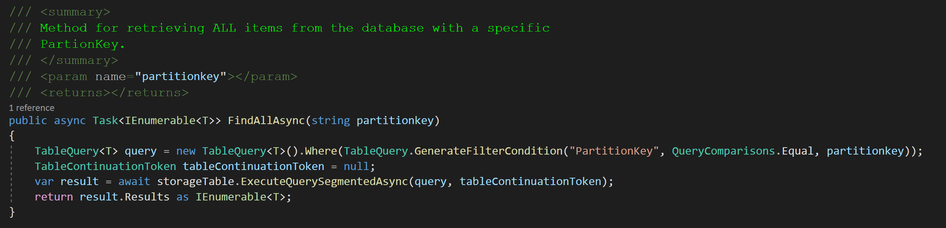
The “FindAllAsync” Method
This will create a “TableQuery” object that allow for filtering the results of a Retrieval from the database. In this case, we want to return all the items that have a specific PartitionKey. Since this is a special operation, we will not use the ExecuteAsync method, but call the database directly with the ExecuteQuerySegmentedAsync method. It will then return the results of the Retrieve operation and will be of IEnumerable<T> type.
Notes:
public async Task<IEnumerable<T>> FindAllByPartitionKeyAsync(string partitionkey)
{
TableQuery<T> query = new TableQuery<T>().Where(TableQuery.GenerateFilterCondition("PartitionKey", QueryComparisons.Equal, partitionkey));
TableContinuationToken tableContinuationToken = null;
var result = await storageTable.ExecuteQuerySegmentedAsync(query, tableContinuationToken);
return result.Results as IEnumerable<T>;
}

Slide 25
Create the IUnitOfWork Interface
The IUnitOfWork Interface will be used to create our UnitOfWork class and will contain everything that will be needed to create the Unit of Work design pattern for our database.
This will consist of:
ConnectionString
This will be the “database” connection information. It can change based on the database that you are using for that specific unit of work.
Repositories
These are the entities of the database that we will be using in the transations. In this current class we will be using the “Book” repository.
Queue of Rollback Actions
This Queue will ensure that if our transaction fails, then everything will be returned to normal the way it was before we started the Unit of Work execution. This is important that it’s a Queue so the order of operations is exactly reversed from the initial operations.
CommitTransaction
This method is the “final” step in our transaction. We will call this when we have done all of the operations for the current transaction and it will ensure that everything is performed properly, and if not, execute the Rollback of the database.

Slide 26
Create the IUnitOfWork Interface

Slide 27
Create the IUnitOfWork Interface

Slide 28
Create the UnitOfWork Class
The UnitOfWork class is where we create the concrete implementation of the IUnitOfWork interface.
This class does the following:
Ensures that Repositories are managed and that associated Azure Cloud Storage Tables are created when a new repository is created and used for a Unit of Work.
Retrieves tables if is already exists in the Azure Cloud Storage. We do not want to create multiple tables of the same type.
Ensures that a transaction is complete, and if not performs the RollbackTransaction methods that are stored in the Queue.
Ensures that these things are done by implementing the IDisposable interface. This interface is a part of .NET and is a way to access a class when it is being removed from the program.
The main purpose of implementing the Idisposable is to ensure that certain operations are done when a class(object) is released from memory. In this case, we want to ensure that our transaction was completed successfully and if not, we want to rollback the transaction to return the database to it’s state before we began the transaction.

Slide 29
Create the UnitOfWork Class

Slide 30
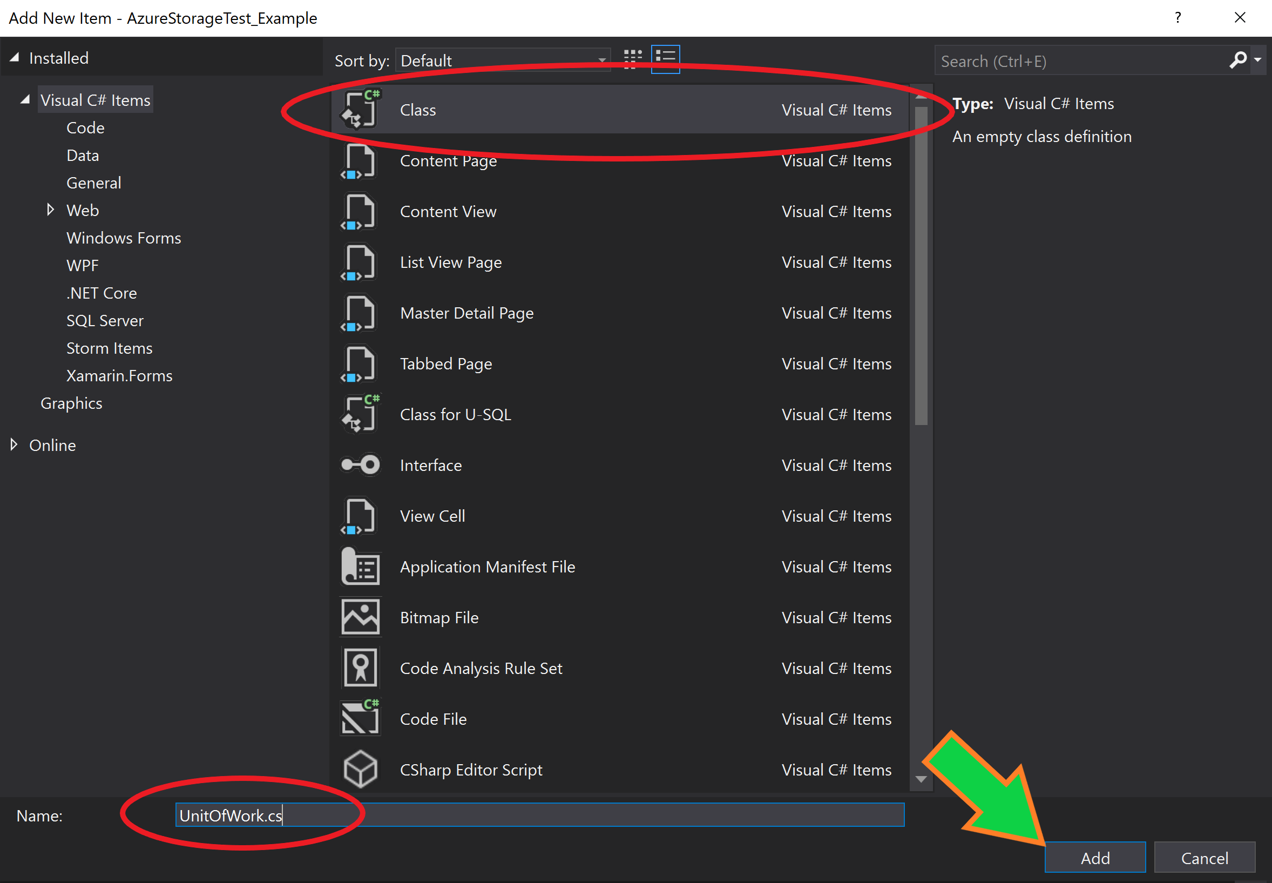
Create the UnitOfWork Class
Notes:
using ASC.DataAccess.Interfaces;
using Microsoft.WindowsAzure.Storage.Table;
using System;
using System.Collections.Generic;
using System.Text;
using System.Threading.Tasks;
namespace ASC.DataAccess {
public class UnitOfWork: IUnitOfWork {
private bool disposed;
private bool complete;
private Dictionary < string,
object > _repositories;
public Queue < Task < Action >> RollbackActions {
get;
set;
}
public string ConnectionString {
get;
set;
}
public UnitOfWork(string connectionString) {
ConnectionString = connectionString;
RollbackActions = new Queue < Task < Action >> ();
}
public void CommitTransaction() {
complete = true;
}∼UnitOfWork() {
Dispose(false);
}
private void Dispose(bool disposing) {
if (disposing) {
try {
if (!complete) RollbackTransaction();
} finally {
RollbackActions.Clear();
}
}
complete = false;
}
public void Dispose() {
Dispose(true);
GC.SuppressFinalize(this);
}
private void RollbackTransaction() {
while (RollbackActions.Count > 0) {
var undoAction = RollbackActions.Dequeue();
undoAction.Result();
}
}
public IRepository < T > Repository < T > () where T: TableEntity {
if (_repositories == null) _repositories = new Dictionary < string,
object > ();
var type = typeof(T).Name;
if (_repositories.ContainsKey(type)) return (IRepository < T > ) _repositories[type];
var repositoryType = typeof(Repository < >);
var repositoryInstance = Activator.CreateInstance(repositoryType.MakeGenericType(typeof(T)), this);
_repositories.Add(type, repositoryInstance);
return (IRepository < T > ) _repositories[type];
}
}
}

Slide 31
Sample CRUD Operations
Now that we have created our Unit of Work pattern, let’s use it in the Program.cs Main method.
We use the keyword “using” to ensure that when we are finished with our Unit of Work, that the Dispose method is called for the Unit of Work. This is a very commonly used practice in .NET and C# to ensure that after we are done with something that is complex, the class is disposed of and the actions that we placed in the IDisposable interface implementation are executed.

Slide 32
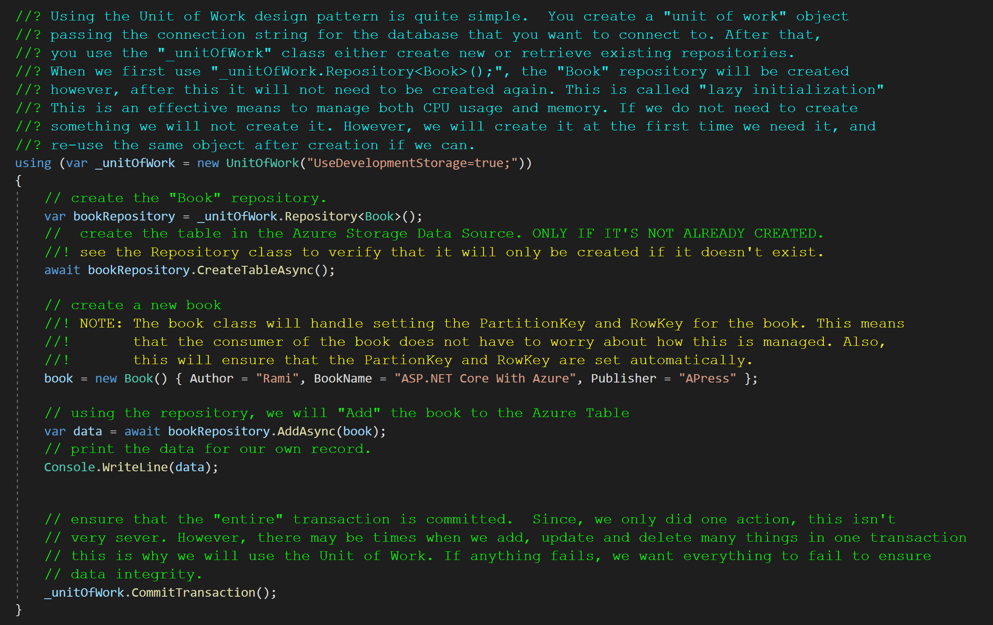
Sample CRUD Operations
Notes:
using(var _unitOfWork = new UnitOfWork("UseDevelopmentStorage=true;")) {
var bookRepository = _unitOfWork.Repository < Book > ();
await bookRepository.CreateTableAsync();
Book book = new Book() {
Author = "Rami",
BookName = "ASP.NET Core With Azure",
Publisher = "APress"
};
book.BookId = 1;
book.RowKey = book.BookId.ToString();
book.PartitionKey = book.Publisher;
var data = await bookRepository.AddAsync(book);
Console.WriteLine(data);
_unitOfWork.CommitTransaction();
}

Slide 33
Auditing the Database Transactions
Database Auditing is the process of storing information about how the database has changed with time. Every CRUD action should be logged with information about what was changed in the database, when it was changed and who changed this information.
Auditing database information is crucial to maintaining a database that is secure and consistent.
Audit information can also be used to monitor the usage of database information for future analysis and optimization of the existing database structure. This is part of the maintenance phase of software development and is crucial for a system that can change with the future needs of a company and their business model.

Slide 34
Auditing the Database Transactions
For the section of the book titled “Auditing Data Through Snapshots” please attempt to do this portion of the book without additional help from a PowerPoint. Consider this your homework.
In the next class we will move these items into the Automobile Service Center Solution. If you believe that you can do this yourself, then please attempt to do this in your ASC.Web solution in the class repository. This Unit of Work pattern will be used in the class project from this point forward and will provide us with the ability to maintain and control data for our application.
From this chapter forward, the Emulated Azure Cloud Storage MUST BE RUNNING for the web application to work as expected. Please ensure that before doing any work, this is running or your application will not work properly.

